Slide 1
Traditional Time Series Prediction
Cyrus Vahid - Principal Solutions Engineer – AWS Deep Engine
Amazon Web Services

Slide 2
Disclaimer
All references in this presentation are from https://otexts.com/fpp2/ unless stated otherwise

Slide 3
What is Forecasting
Predicting a future event based on temporal patterns of its past.
Predictability of an event depends on:
Understanding of underlying casual structure.
Known facts and figures about a phenomenon.
Regularity of patterns.
Effects of external factors.
How far in the future we would like to make a prediction.

Slide 4
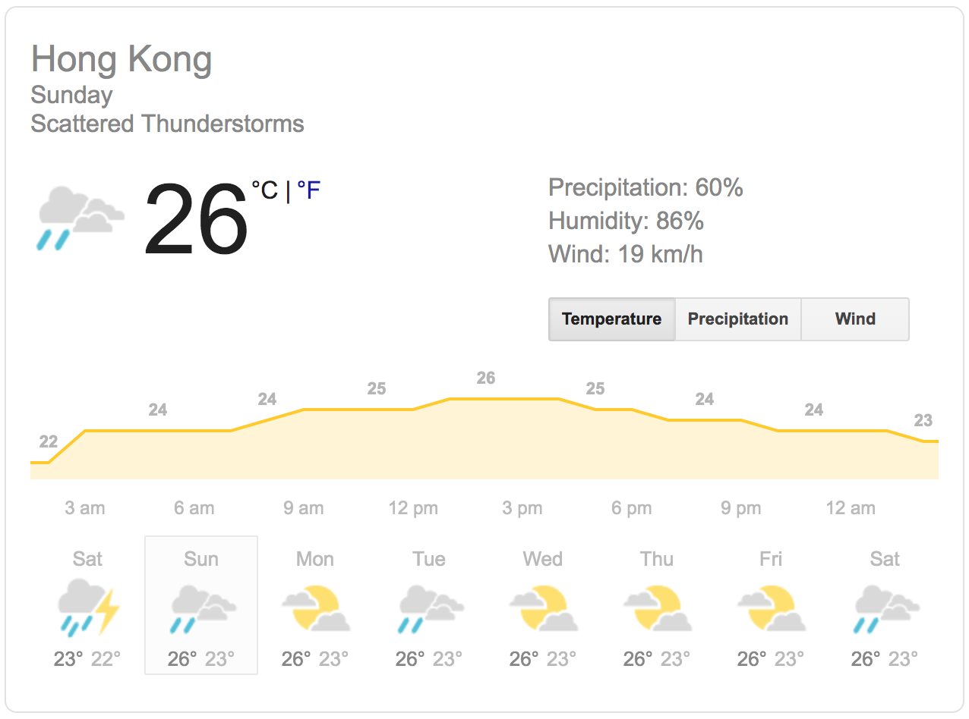
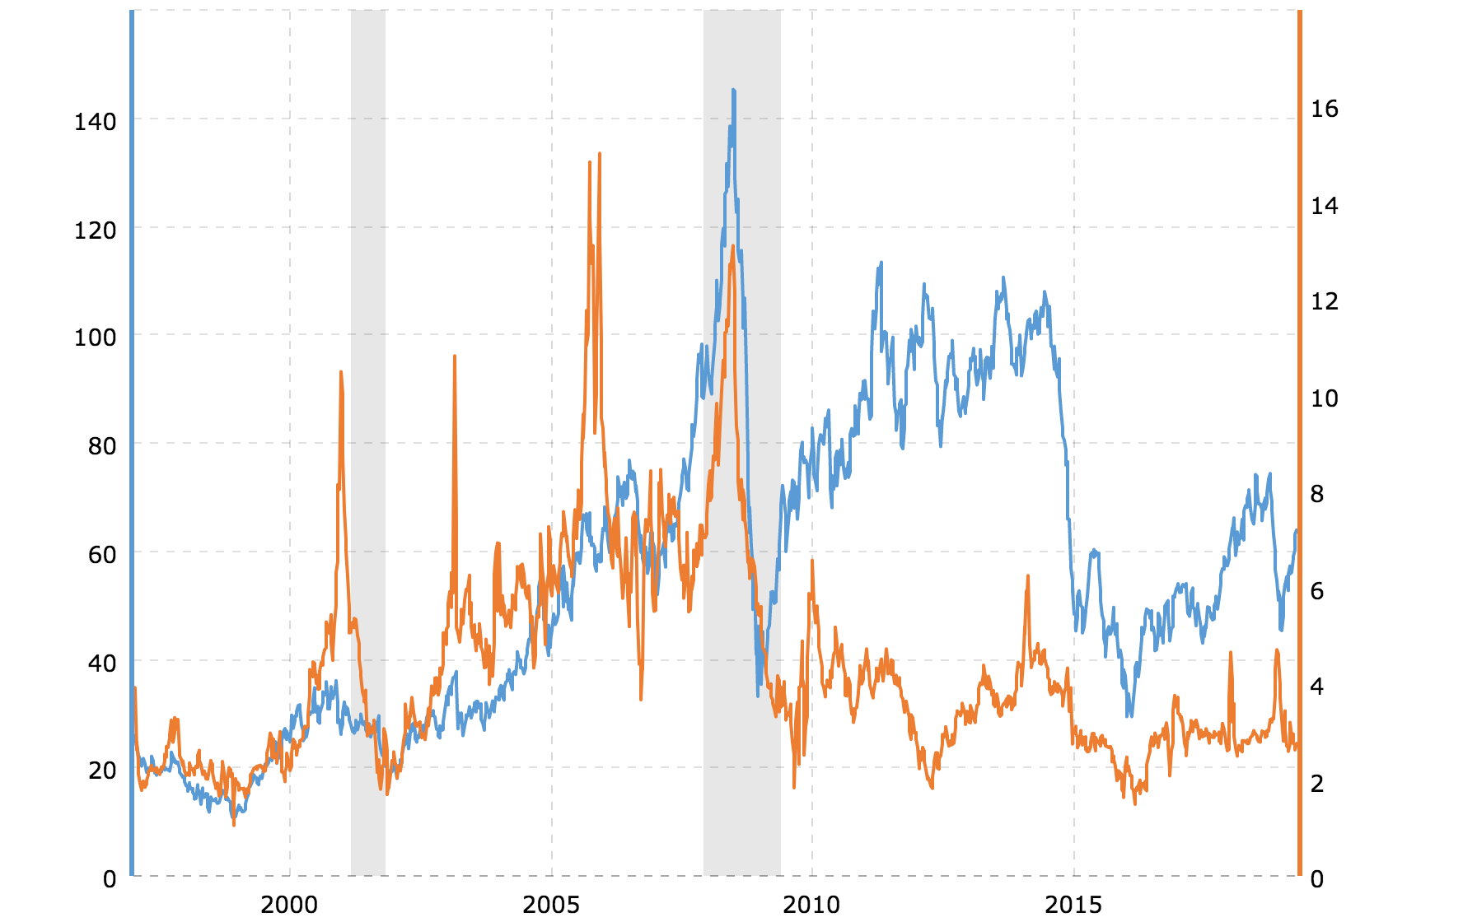
Examples
Weather
LPG vs Oil Price*
(NYT) Forecast Chart, Long-Term**
* https://www.macrotrends.net/2500/crude-oil-vs-natural-gas-chart
** https://walletinvestor.com/stock-forecast/nyt-stock-prediction

Slide 5
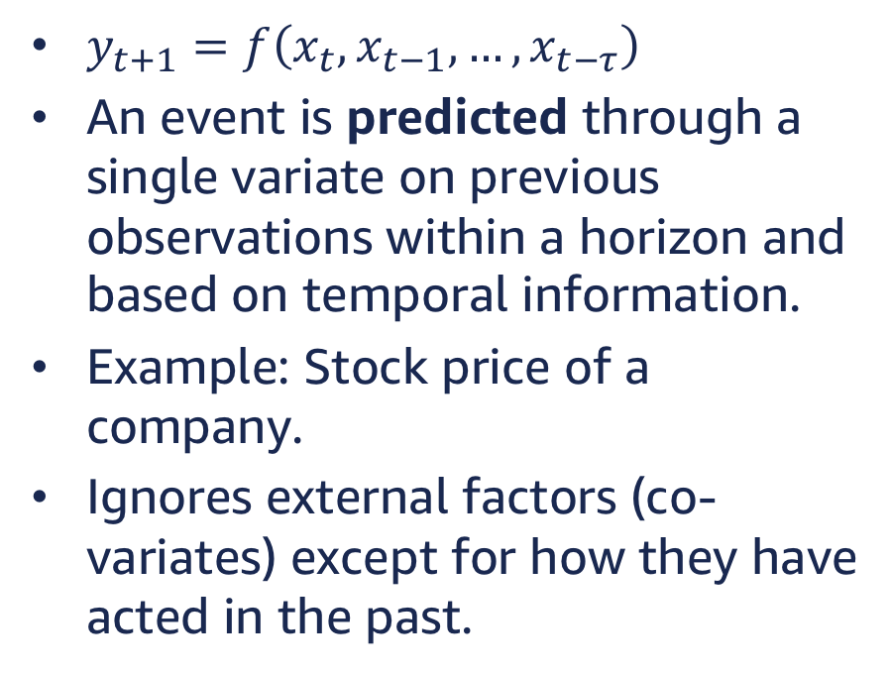
Time Series
$y_{t+1}=f\left(x_{t}, x_{t−1}, …, x_{t−τ}\right)$
An event is predicted through a single variate on previous observations within a horizon and based on temporal information.
Example: Stock price of a company.
Ignores external factors (co-variates) except for how they have acted in the past.

Slide 6
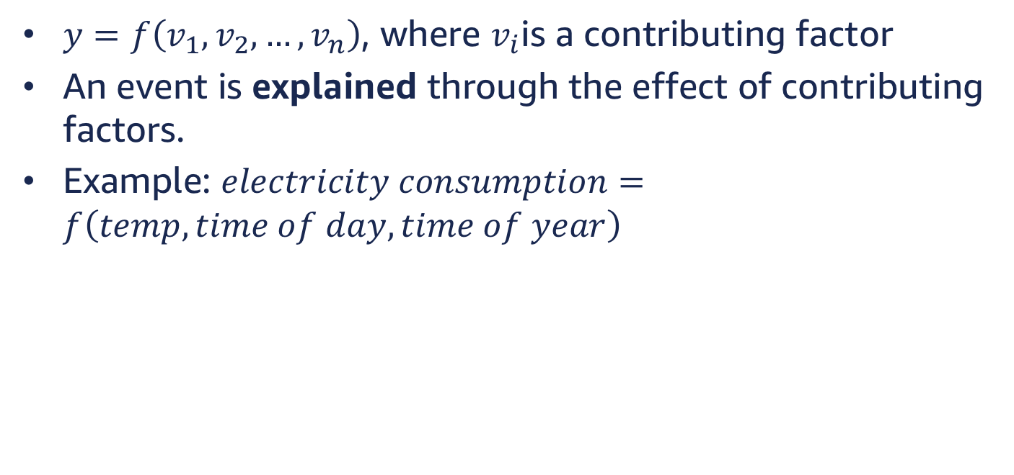
Predictor Variables
$y=f\left(v_{1}, v_{2}, …,v_{n}\right)$, where $v_{i}$is a contributing factor
An event is explained through the effect of contributing factors.
Example: $electricity consumption=f\left(temp, time of day, time of year\right)$

Slide 7
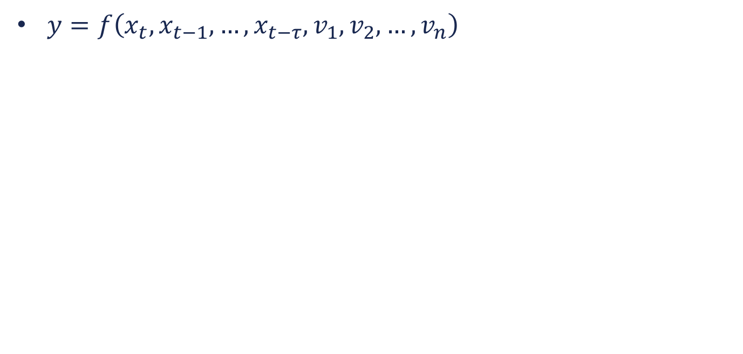
Mixing the Two
$y=f\left({x_{t}, x_{t−1}, …, x_{t−τ},v}_{1}, v_{2}, …,v_{n}\right)$

Slide 8
Time Series Patterns
Trend: Long-term increase or decrease in data
Seasonal: Time series is affected by time on a repeating cycle like day of the week
Cyclic: Data exhibits rise and fall that are not of fixed frequency

Slide 9
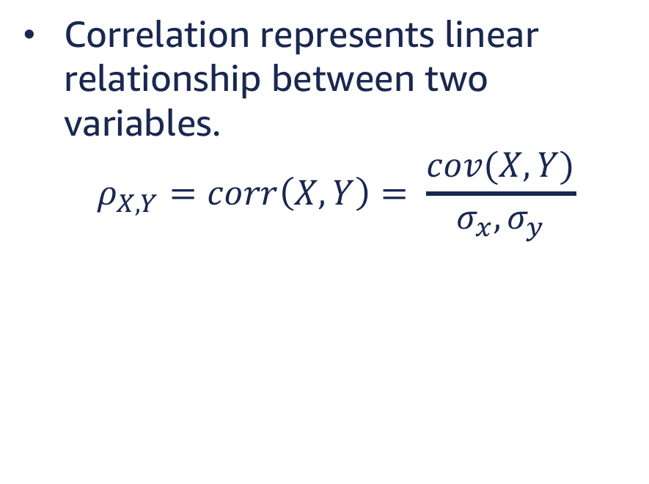
Correlation
Correlation represents linear relationship between two variables.
$$ρ_{X,Y}=corr\left(X,Y\right)= \frac{cov(X,Y)}{σ_{x}, σ_{y}}$$
('pearsonr', 0.9999999999999806)
('pearsonr', -0.7555376286574912)

Slide 10
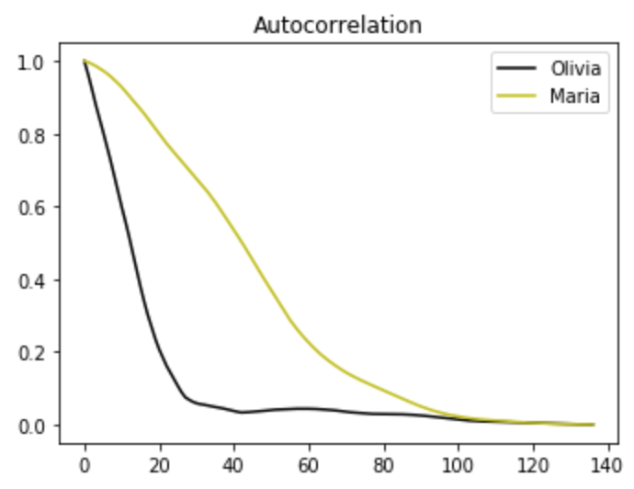
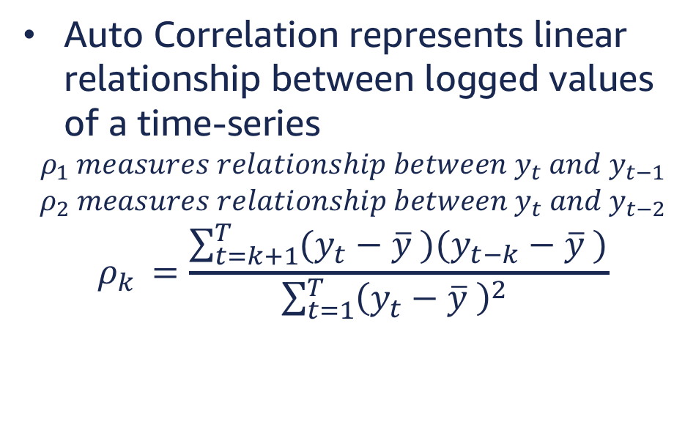
Auto Correlation
Auto Correlation represents linear relationship between logged values of a time-series
$$ρ_{1} measures relationship between y_{t} and y_{t−1}$$
$$ρ_{2} measures relationship between y_{t} and y_{t−2}$$
$$ρ_{k }=\frac{\sum_{t=k+1}^{T}{(y_{t}−\overline{y} )(y_{t−k}−\overline{y} )}}{\sum_{t=1}^{T}{{\left(y_{t}−\overline{y} \right)}^{2} }}$$

Slide 11
White Noise
Time series that show no autocorrelation are called white noise.

Slide 12
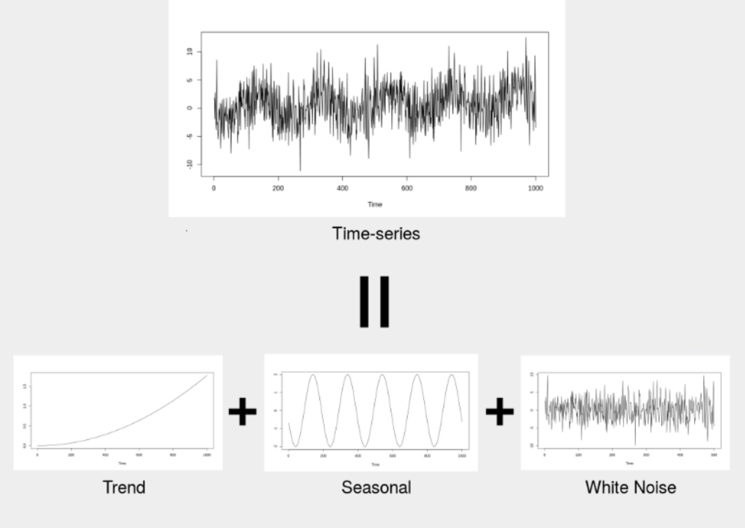
Time Series Decomposition
We can decompose a time-series into its patterns, trend, seasonal, and cycling.

Slide 13
Stationary Time Series
A stationary time series is one whose properties do not depend on the time at which the series is observed.
Time series with trends and seasonality are not stationary.
White noise and cyclic time series with no pattern or trend are stationary.
In methods described in this presentation, stationary time-series have no long-term predictable patterns.

Slide 14
Differencing
Differencing is calculating differences between consecutive observations.
We can use differencing to transform a non-stationary time series to a stationary one.
Differencing can help stabilise the mean of a time series by removing changes in the level of a time series

Slide 15
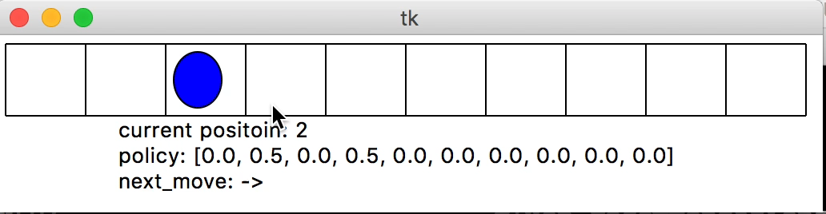
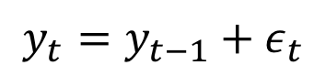
Random Walk Model
$$y_{t}=y_{t−1}+ε_{t}$$
Position of the next step depends on current step plus white noise.

Slide 16
What are the RW models good for?
Random walk models are widely used for non-stationary data, particularly financial and economic data. Random walks typically have:
long periods of apparent trends up or down
sudden and unpredictable changes in direction.

Slide 17
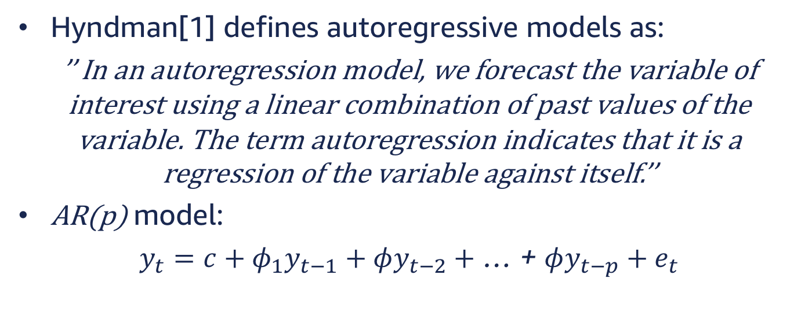
Autoregressive Models
Hyndman[1] defines autoregressive models as:
’’ In an autoregression model, we forecast the variable of interest using a linear combination of past values of the variable. The term autoregression indicates that it is a regression of the variable against itself.’’
AR(p) model:
$y_{t}=c+φ_{1}y_{t−1}+φy_{t−2}+$ … + $φy_{t−p}+e_{t}$

Slide 18
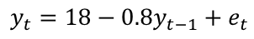
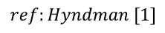
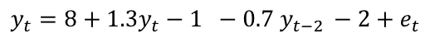
Auto Regressive Models
Autoregressive models are remarkably flexible at handling a wide range of different time series patterns.
$$y_{t}=18−0.8y_{t−1}+e_{t}$$
$$y_{t}=8+1.3y_{t}−1 −0.7 y_{t−2 }−2+e_{t}$$
$$ref:Hyndman [1]$$

Slide 19
What are AR models good for?
An autoregressive model is one that uses previous time steps and some randomness to determine the current time step; therefore they are used for non-stationary time-series.

Slide 20
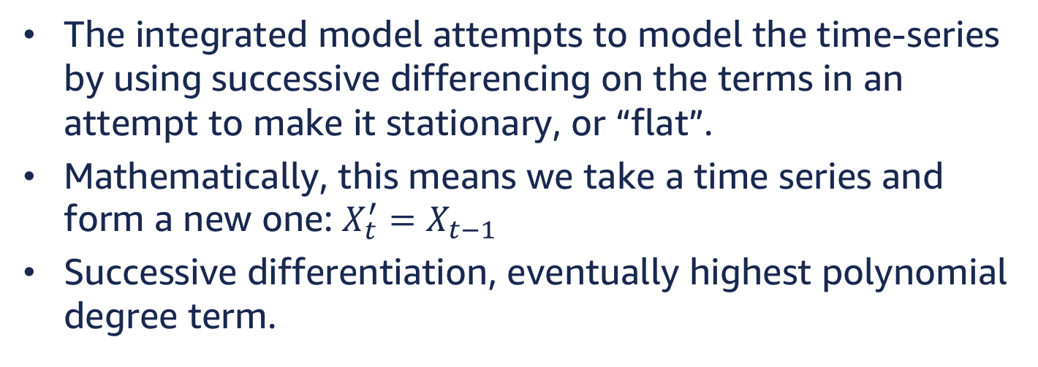
Integrated Models
The integrated model attempts to model the time-series by using successive differencing on the terms in an attempt to make it stationary, or “flat”.
Mathematically, this means we take a time series and form a new one: $X_{t}^{′}=X_{t−1}$
Successive differentiation, eventually highest polynomial degree term.

Slide 21
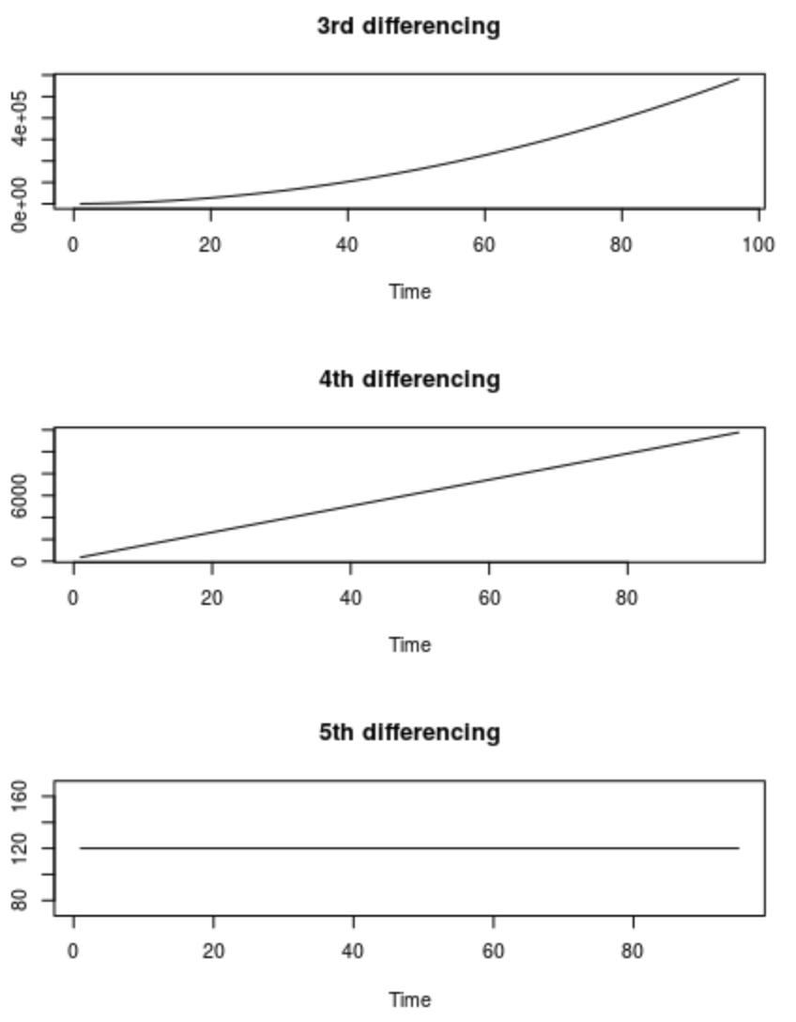
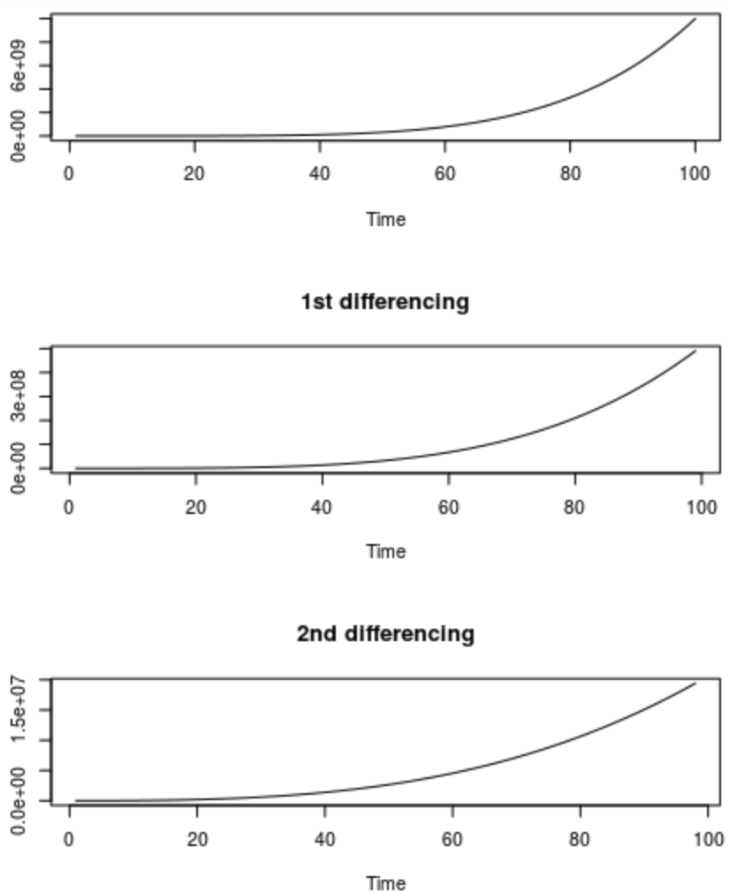
Integrated Models

Slide 22
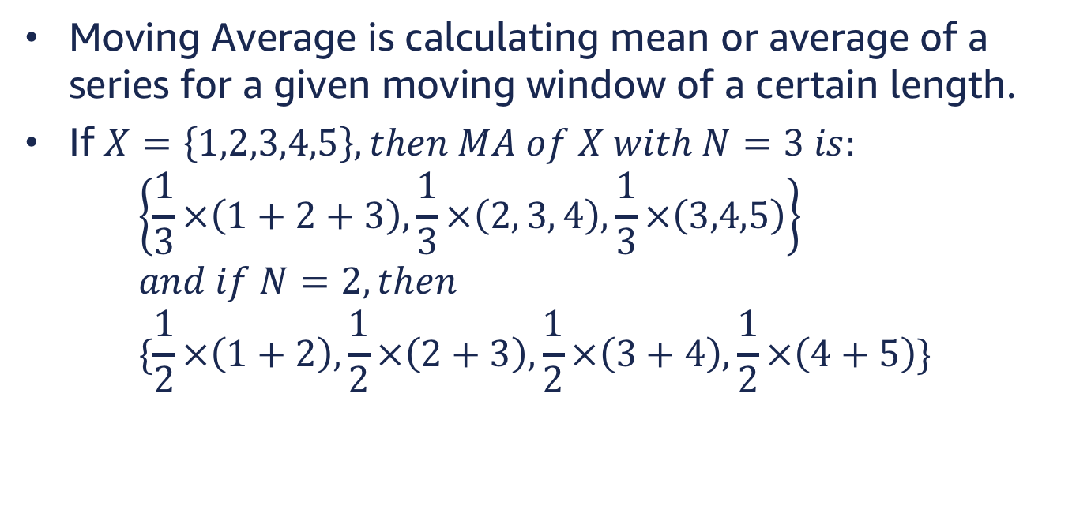
Moving Average Model
Moving Average is calculating mean or average of a series for a given moving window of a certain length.
If $X=\left\{1,2,3,4,5\right\}, then MA of X with N=3 is:$ $\left\{\frac{1}{3}×\left(1+2+3\right),\frac{1}{3}×\left(2, 3, 4\right),\frac{1}{3}×\left(3,4,5\right)\right\}$ $and if N=2, then$ $\{\frac{1}{2}×\left(1+2\right),\frac{1}{2}×\left(2+3\right),\frac{1}{2}×\left(3+4\right),\frac{1}{2}×\left(4+5\right)\}$

Slide 23
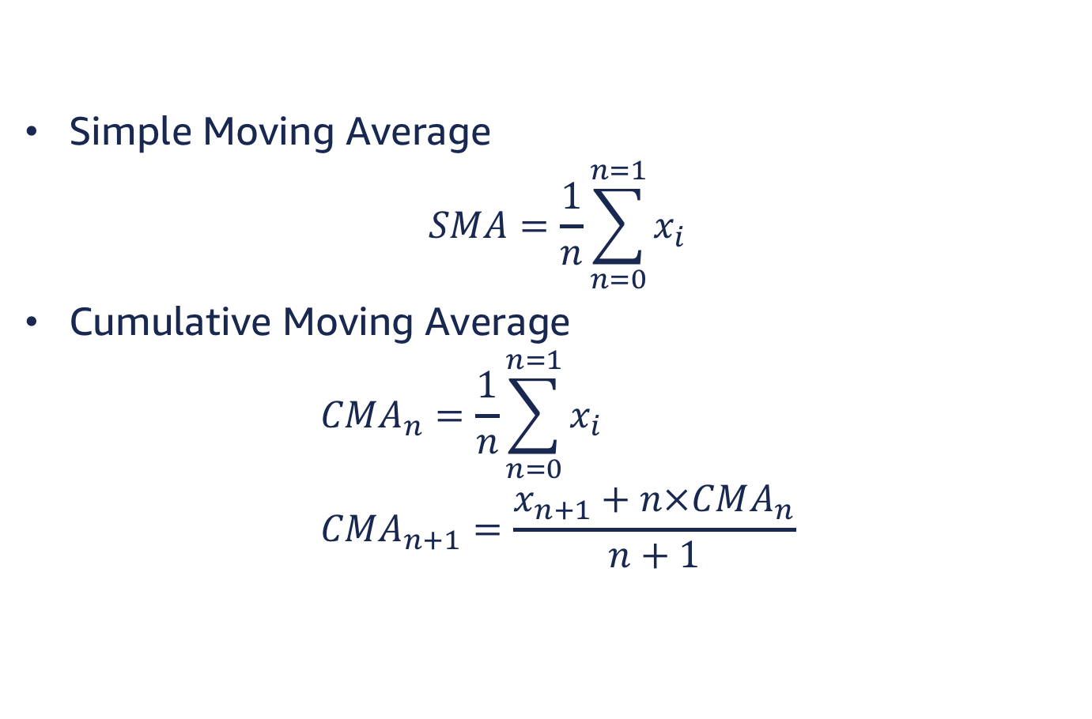
Moving Average
Simple Moving Average
$$SMA=\frac{1}{n}\sum_{n=0}^{n=1}{x_{i}}$$
Cumulative Moving Average
$$CMA_{n}=\frac{1}{n}\sum_{n=0}^{n=1}{x_{i}} \\ CMA_{n+1}=\frac{x_{n+1}+n×CMA_{n}}{n+1}$$

Slide 24
Moving Average Smoothing
Smoothing refers to process of reducing jittery randomness from data.
https://startpythonml.wordpress.com/2016/03/13/smoothed-moving-average-and-variations/

Slide 25
What MA models are good for?
Capturing stationary time-series.

Slide 26
ARIMA and ARMA models
ARIMA: Autoregressive Integrated Moving Average.
Combining AR, I, and MA.
Decomposes a model to several model and benefits from different models capturing different aspects of time-series.
Autoregressive Moving Average
Combining AR and MA.
Decomposes models to sub models that capture different aspects of time-series.

Slide 27
Challenges faced by existing models
Most methods are designed to forecasting individual series or small groups. New set of problems have emerged that require to predict series.
In recent years problem of forecasting a large number of individual or grouped time series.
Trying to learn a global model facing the difficulty of dealing with scale of different time-series that would otherwise be related.
Many older models cannot account for environmental inputs.

